Slide 1




HOW TO ORGANISE THE ERASMUS+ TRAINEESHIP?
Początek

Slide 2


Who can go abroad?
Początek
Students of TUL:
I cycle (after second year)
II cycle (after first semester)
not on leave of any type
Doctoral candidates of TUL:
III cycle (after first semester)
not on leave of any type
Recent graduates of TUL:
recruitment necessary while being a student
the traineeship must be finished within 1 year from completion of the studies

Slide 3

M
O
N
T
H
S
Each candidate has a „mobility capital” of 360 days to use on Erasmus+ for studies/traineeships on each study cycle

Slide 4


Where can I go?

Slide 5
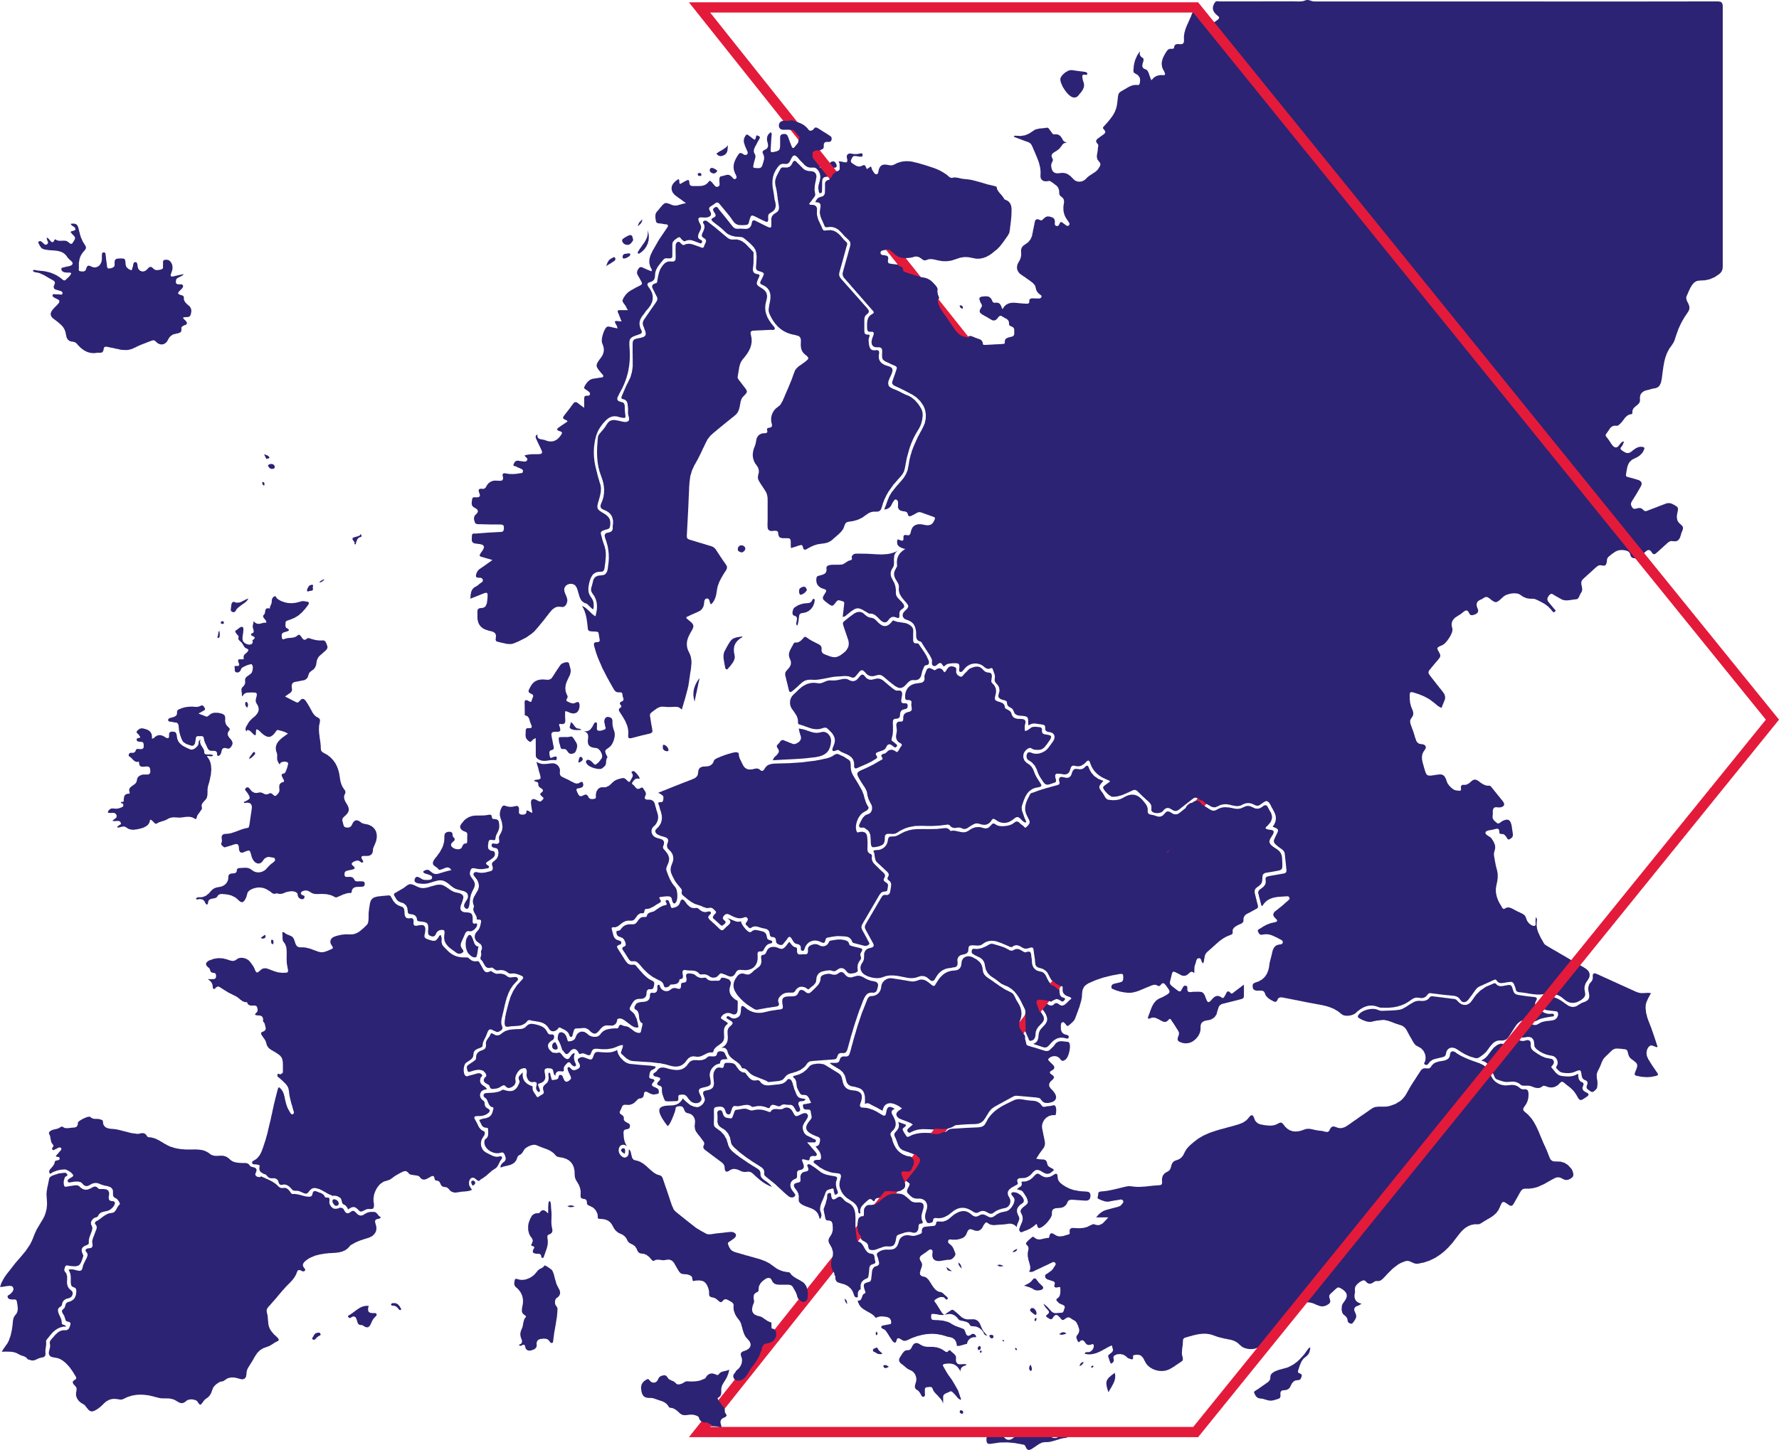

EU countries
Norway, Iceland, Liechtenstein, Turkey, Macedonia, Serbia, United Kingdom

Slide 6




Spain
Italy
Belgium
Germany
… and many more!

Slide 7

The traineeship cannot be shorter than 60 days.
Funding is granted for a maximum of 180 days.

Slide 8
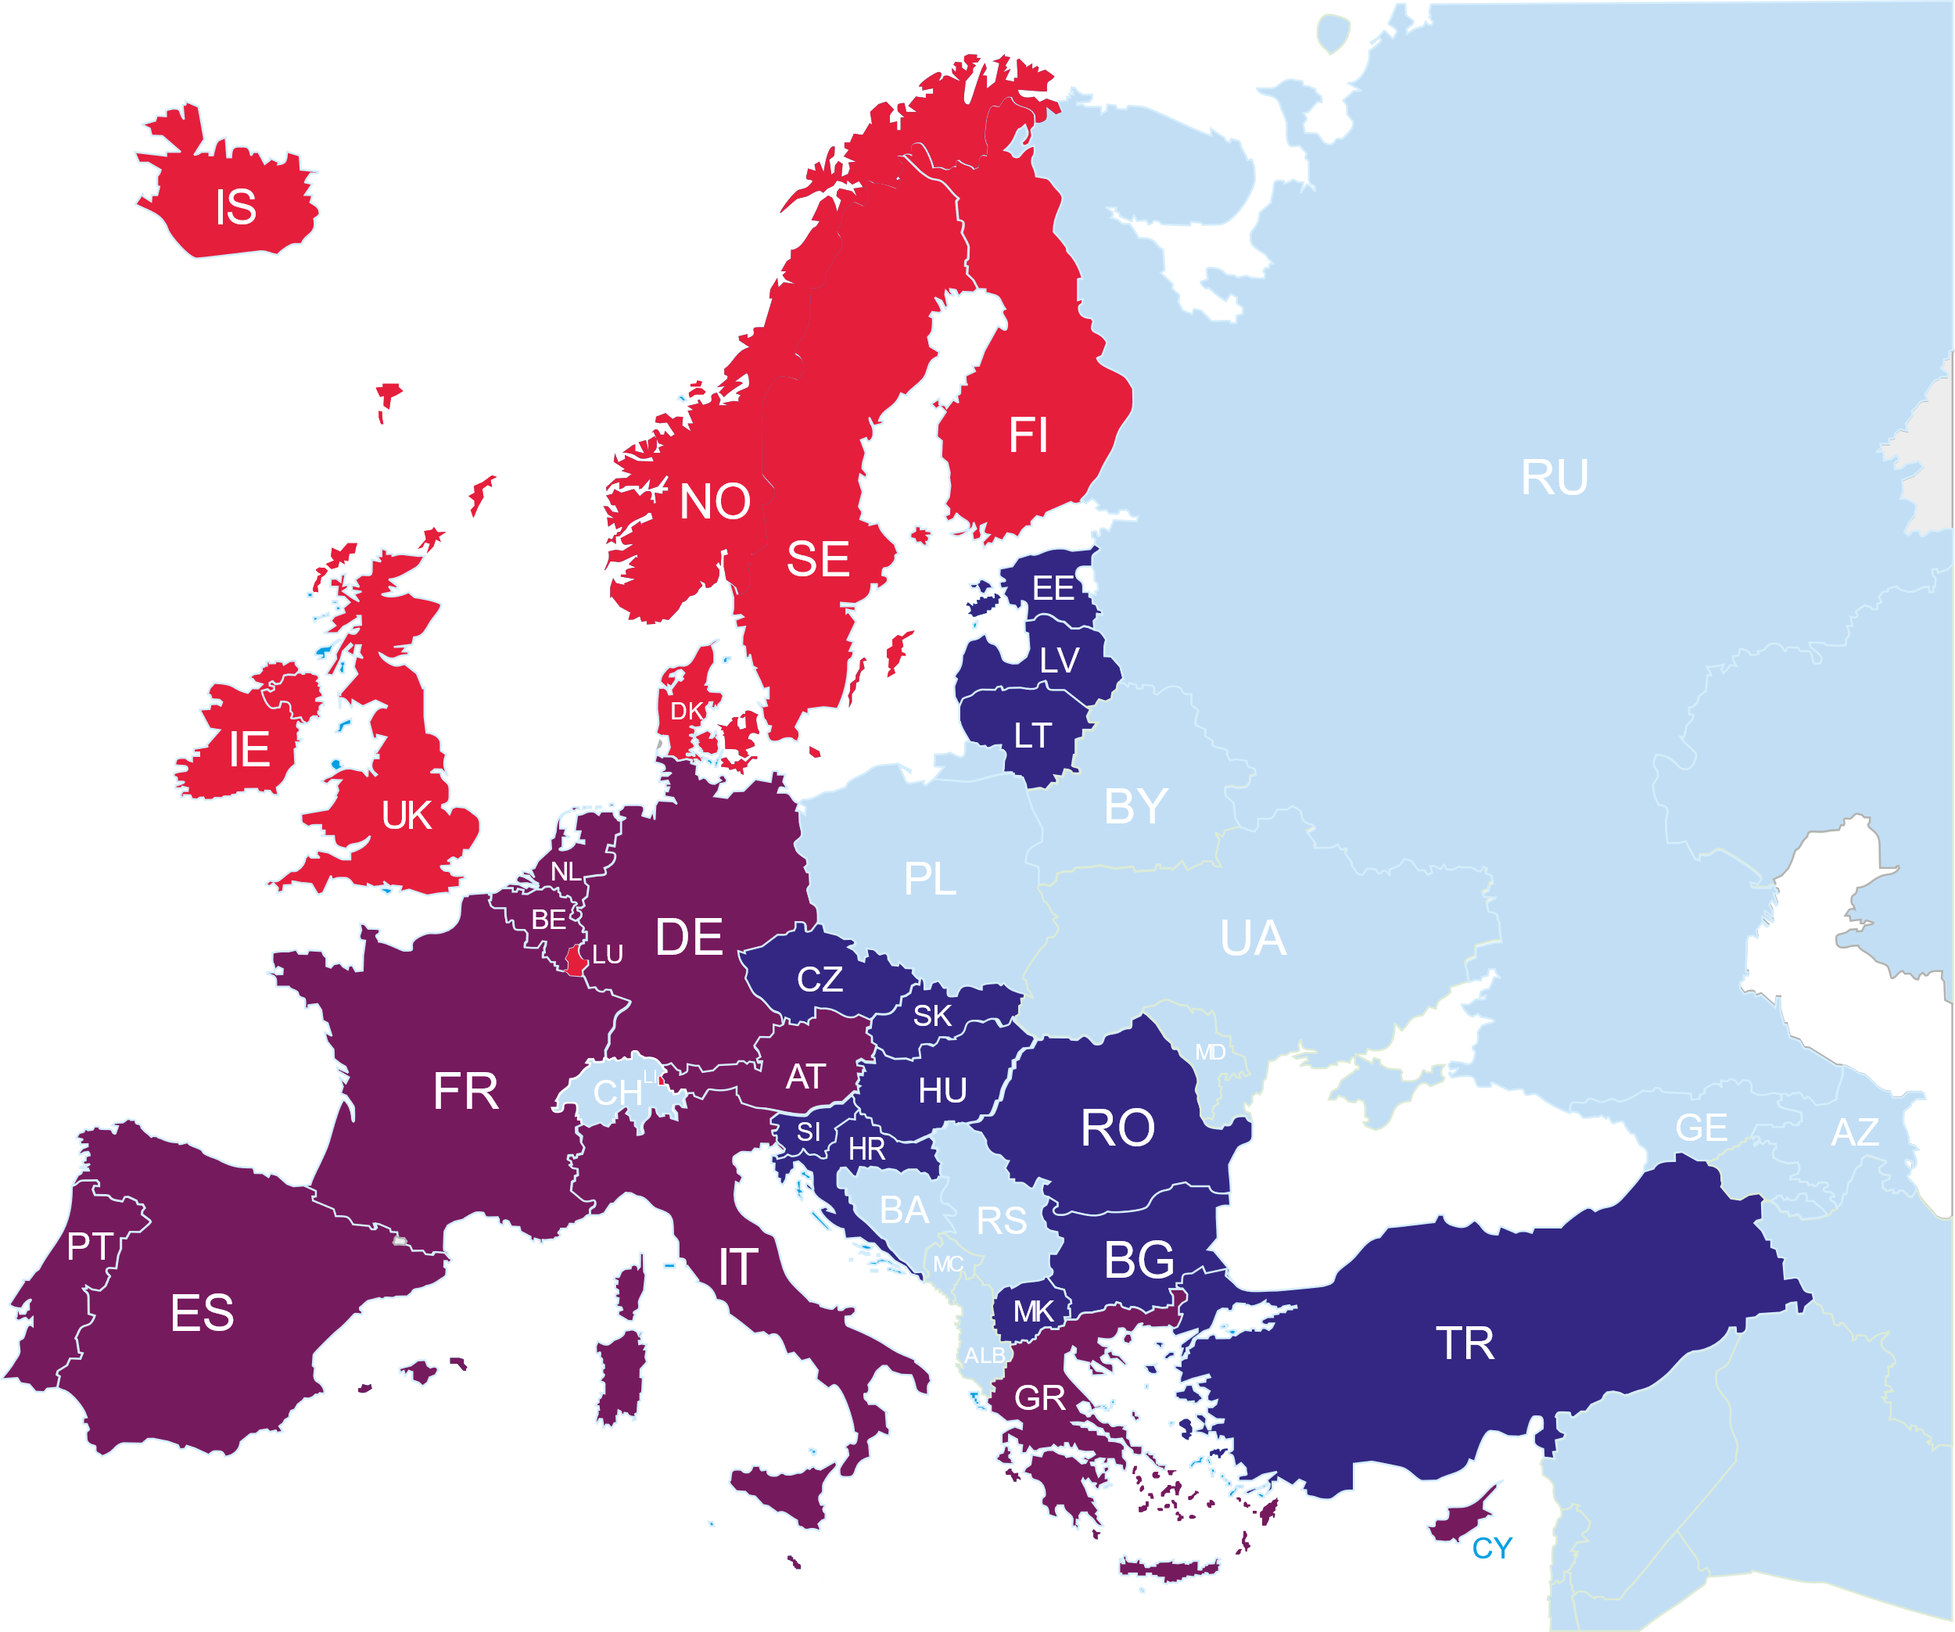



820 EUR
Ireland, Iceland, Denmark, Norway, Sweden, Finland, Luxembourg, Liechtenstein, United Kingdom
Higher grant to Iceland and Norway is available from EOG funds (>1000 EUR)
820 EUR
Portugal, Spain, France, Belgium, the Netherlands, Germany, Italy, Austria, Malta, Greece, Cyprus
750 EUR
Estonia, Latvia, Lithuania, Czech Republic, Slovakia, Hungary, Slovenia, Croatia, Romania, Bulgaria, Macedonia (FYROM), Turkey, Serbia

Slide 9
Additional support for participants -
250 EUR per month:
*Each candidate receives a one-off support payment of 250 euro from University, after positive Deans decision.
for students/graduates who receive social grant
for participants with special needs
* Once per academic year, not available for recent graduates.

Slide 10

What to do first?

Slide 11
Step by step
Find a traineeship
Send your cv with cover
letter to the company,
university etc.
Submit neccesary documents
Check the recruitment schedule and submit the required application documents
Wait for the final decision
The qualification results will be sent to your University email address within given deadline
Sign the Agreement
After providing all necesary insurances the traineeship agreement will be prepared
Please check the recruitment schedule - https://cwm.p.lodz.pl/en/student-mobility/traineeships/erasmus/schedule

Slide 12

Where can I find a traineeship?
https://erasmusintern.org/ or other traineeship provider platforms
Via private contacts with former Erasmus+ students, teachers etc.
Erasmus Politechnika Łódzka on Facebook

Slide 13
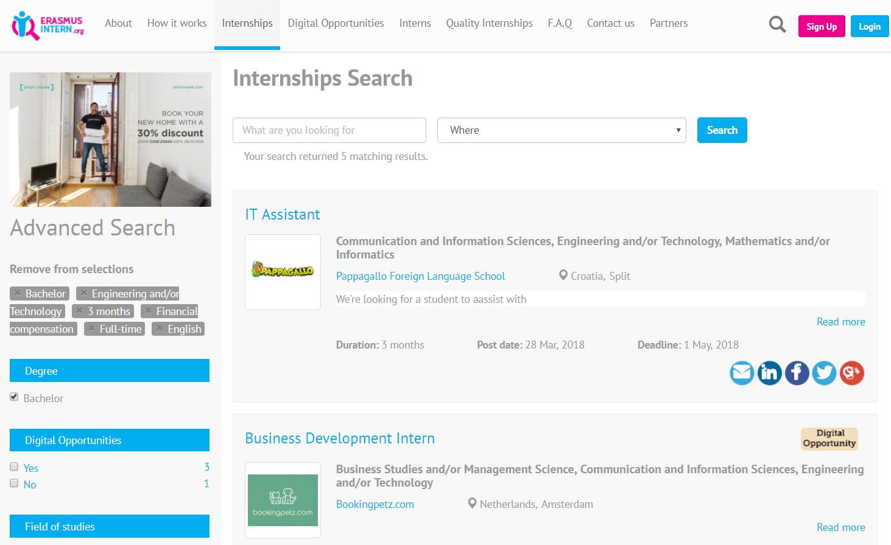
http://erasmusintern.org/
8

Slide 14
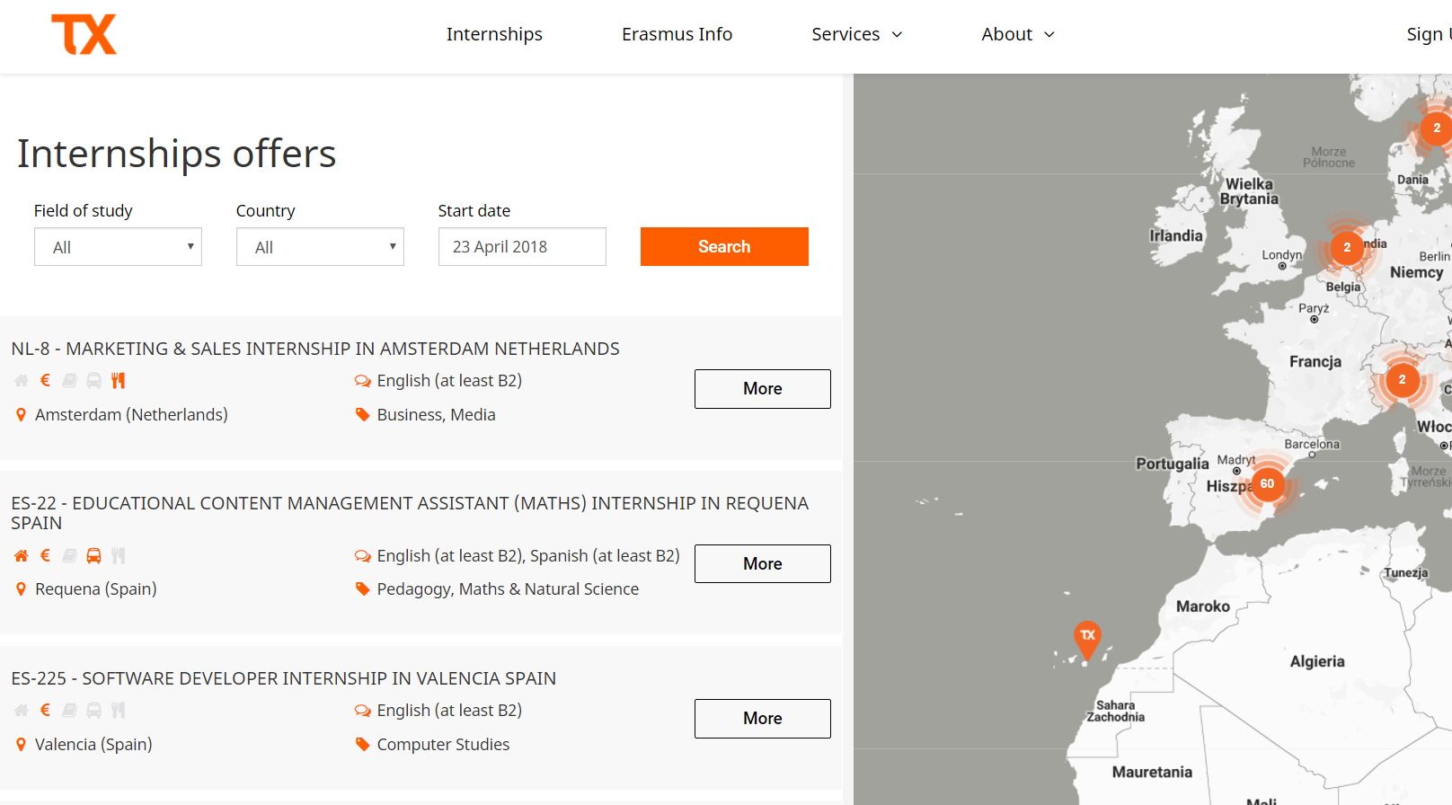
https://www.trainingexperience.org/
9

Slide 15


What to do next after getting acceptance from the Host Institution?
Once the document is signed and stamped– the Host should send you a scan version of it
Print the document, sign it and submit with other qualification documents to the Faculty Coordinator/Supervisor and Training Coordinator Program
Wait for the results
Sign the agreement and enjoy the traineeship ☺
Send editable version of Learning Agreement for Traineeship to the Host institution

Slide 16

Required qualification documents:
Application of a student or doctoral candidate
Application form
Cv
Cover letter
Learning Agreement for the Traineeship
Proof of the language competency
All documents are available on our website – https://cwm.p.lodz.pl/en/student-mobility/traineeships/erasmus/traineeship

Slide 17

Other important information

Slide 18
Did you:
miss the deadline for the qualification procedure? Do not worry – contact the Student Mobility Division to find out what to do next
get any stipends before going abroad? You are going to keep them while being abroad
think of a traineeship for recent graduates? Make sure you apply while being a student!

Slide 19


Slide 20
Contact
Student Mobility Division
  International Cooperation Centre (building A16), room 120
  www.cwm.p.lodz.pl/en
Any questions? Please contact Ewa Jarzębowska via email ewa.jarzebowska@p.lodz.pl or by phone 4842 638 38 68

